Slide 1
Should Our Investor Invest in an AirBnB hotel in Washington, D.C.?
Nancy Tran
Notes:
If so, in which neighborhood should they invest?

Slide 2
How much revenue do successful hosts generate?

Slide 3
Data Cleansing
First, hiding the columns that’s not needed, which makes it easier for me to check my columns when I need to calculate. Did not delete just in case if I have to go back to it.
Wrap the text, and centered and middle aligned, and froze the first row.
Changed all the Washington, D.C. to just Washington, took out Washington from Capitol Hill, took out middle of DC! From Columbia Heights, and capitalized the first letter in Chevy Chase from the city column.
Changed all Mt and Mt. to Mount and St to Saint in the neighborhood column

Slide 4

First, calculate the daily revenue for each listing
We can assume that 50% of customers who stayed left a review, so we can calculate an estimate number of stays for each listing
We can also assume that each of the booking always has two guests, unless the listing accommodates only one.
The listing is for only one person if there’s only one guest included and it accommodates one, which means it is just the price for the one person.
We would have to add the extra cost if the listing is for one guest included and it accommodates more than one.
If the guest included is more than one, then we only charge the price because the price includes more than one person and we are assuming each booking always has two guests.
Notes:
Multiply the number of reviews by 2
Price of the booking is just for 1 person. Add extra people cost if there’s 2.
If guest included > accommodates, we can imagine there’s bunk beds in the same bedroom
Guest included > 1 means price is included with 2 or more guests

Slide 5
Now to calculate total revenue!
Multiply the daily revenue by the minimum of nights to calculate an estimated revenue per booking
Multiply the estimated revenue per booking with the estimated number of stays that we calculated on the very first step
Time to get rid of the listings we don’t need!
Notes:
Get rid of the listings that have an est total rev of 0. Not relevant to our subprompt

Slide 6
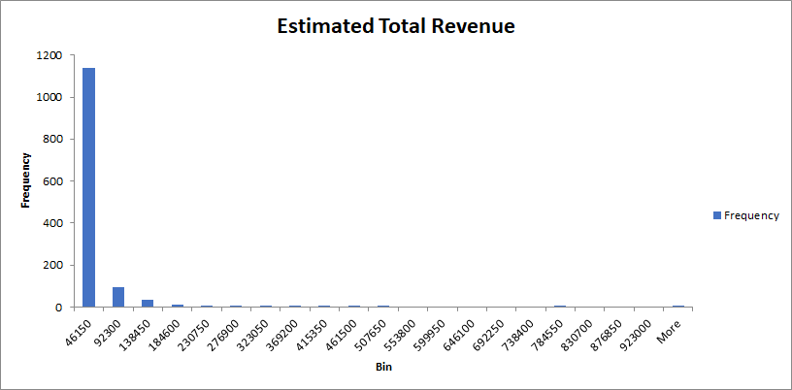
Let’s take a look on the histogram with all the estimated total revenue...
Notes:
Finding the histogram of the estimated total revenue will help us figure out how spread out the data is. Well that’s not pretty nor did it contain useful information…. Let’s try again with the first $50,000 and increments of $5,000 to get 10 bins

Slide 7
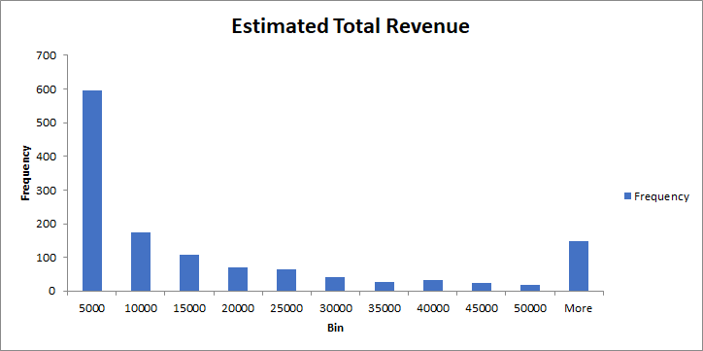
Much better! Now what does this tell us?
Notes:
Shows most of the estimated total revenue falls within the first $5,000. We see second most within $5,000 to $10,000. Then more than $50,000

Slide 8
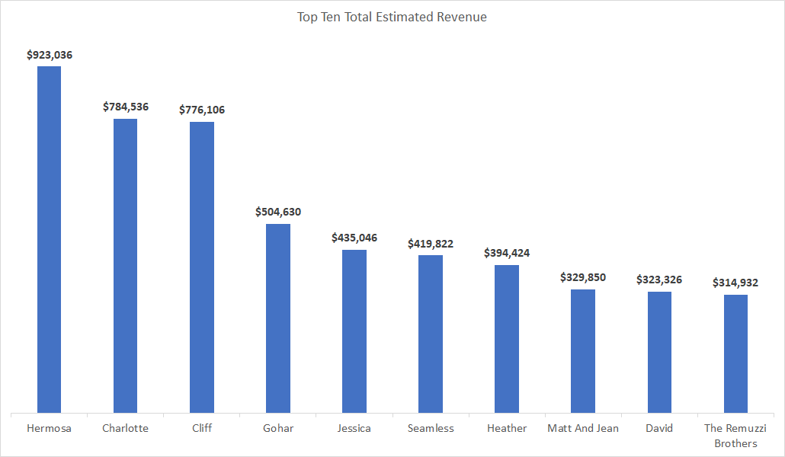
Now let’s look at who are our top 10 hosts who generated the most revenue within D.C.
Notes:
After creating a pivot table with the host names, sum of estimated top rev, and count of ID, I created another sheet with the results and placed the revenue in a descending order to grab the information for the top 10. I created a bar chart to help us see who are the top 10 hosts that generated the most revenue in D.C.

Slide 9
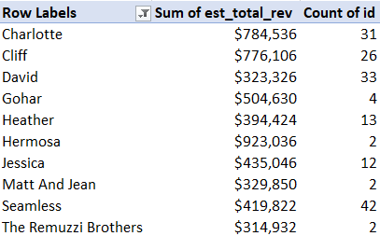
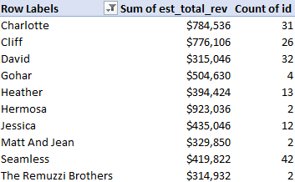
Comparing the top 10 hosts for all of D.C. vs. Washington, D.C.
Notes:
The left one shows the pivot table for the top ten hosts who generated the most revenue in ALL of D.C. The right shows the top ten only in Washington, D.C. The top 10 are exactly the same. The only difference you see here is David has one listing that is not in Washington, D.C.

Slide 10
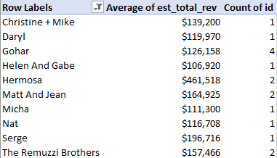
Sum vs. Average
Notes:
Now let’s look at the top 10 performing hosts on their sum of estimated total revenue vs their average of estimated total revenue in Washington, D.C. We could see that both Gohar, Matt and Jean, and The Remuzzi Brothers appeared in both.

Slide 11
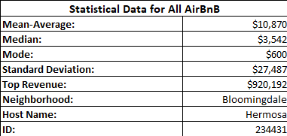
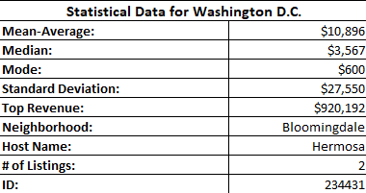
Entire D.C. versus Washington, D.C.
Notes:
We can see that the mean average and the median of the estimated total rev is slightly higher in Washington, D.C.
The standard deviation shows how spread about the data is from the mean average. Since both of them have a high standard deviation compared to the mean average, this means the data is more spread out (as we can see in the histogram). Both of these data show the top listing is hosted by Hermosa.

Slide 12
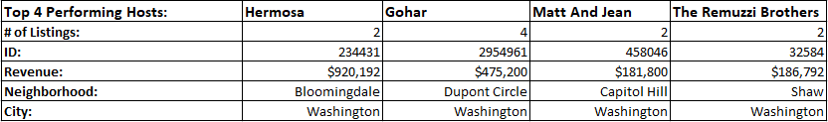
Top Performing Hosts Recommendations
Notes:
These are the top four performing hosts we should target. Hermosa is a high risk but a high reward investment for her total rev, but only has 2 total listings. Her top generated revenue in one listing made about $920k in the neighborhood of Bloomingdale. Gohar, the Remuzzi Brothers, and Matt and Jean would also be ones we should target because their average rev is more than the mean average and the median of Washington, D.C. The sums of their revenue is also one of the top 10 in Washington, D.C. These three hosts are more promising. Notice that all of their top listings are located in Washington, D.C.

Slide 13
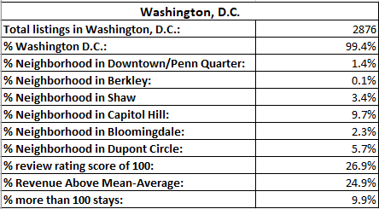
Should our investor invest in an AirBnB hotel in Washington, D.C.?
Notes:
Out of 2,894 listings, there are 2,876 in Washington, D.C.
99.4% of the listings in Washington, D.C.
All of our top performing hosts had their top listing in Washington, D.C.
Almost 25% of the revenue in Washington D.C. is above the mean average ($10,896). Pretty good.

Slide 14
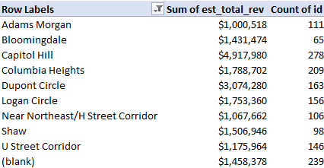
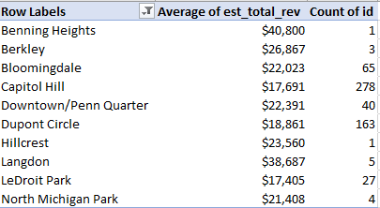
Which neighborhood in Washington, D.C. should they invest?
Bloomingdale would be the best fit!
Notes:
Even though Capitol Hill made more total revenue, there were 278 listings to accumulate $4 mil. Since there are so many listings in Capitol Hill, I believe that this neighborhood would be a bad choice. Same with Dupont Circle. Even though their revenue is great, there are 163 listings to add up to $3 mil. Bloomingdale has only 65 listings and this neighborhood appeared in both the top 10 for the sum of the estimated total revenue and their average of the estimated total revenue. It also caught my attention that it is the least amount of listings in the top 10 of the sum of the estimated total revenue.

